Slide 1

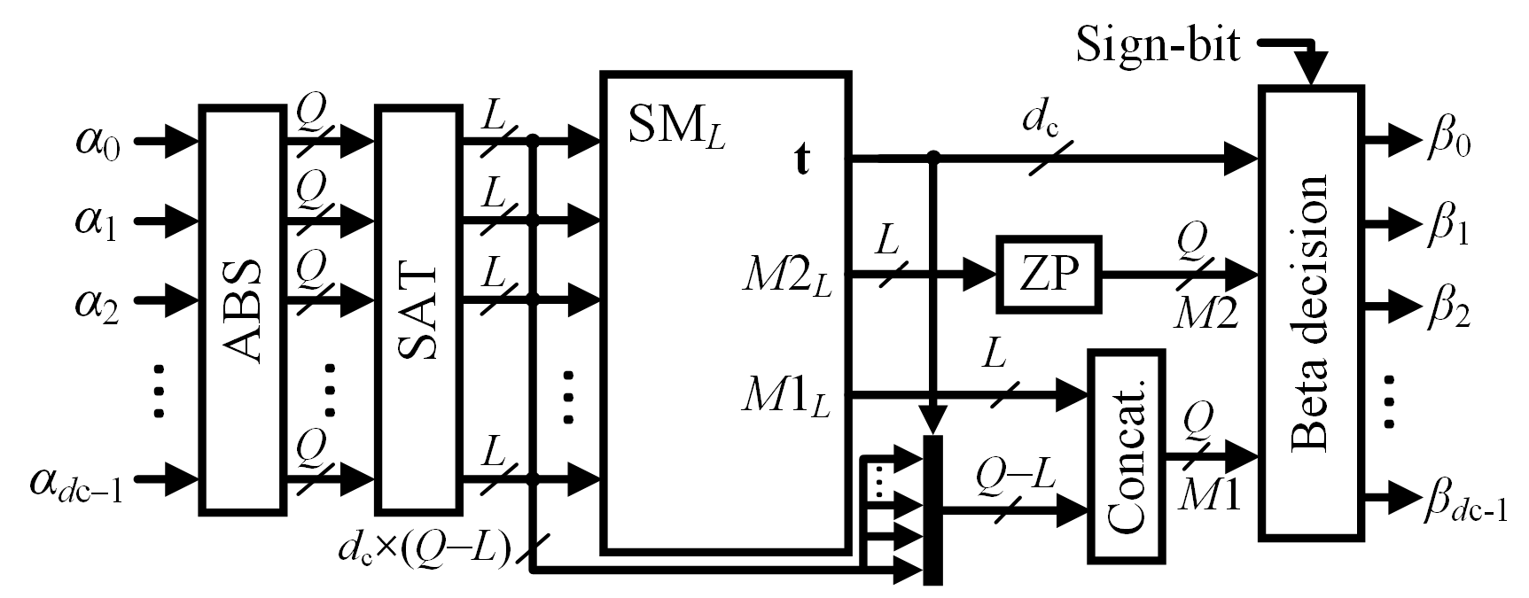
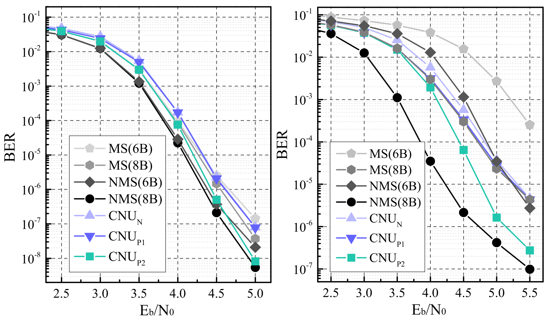
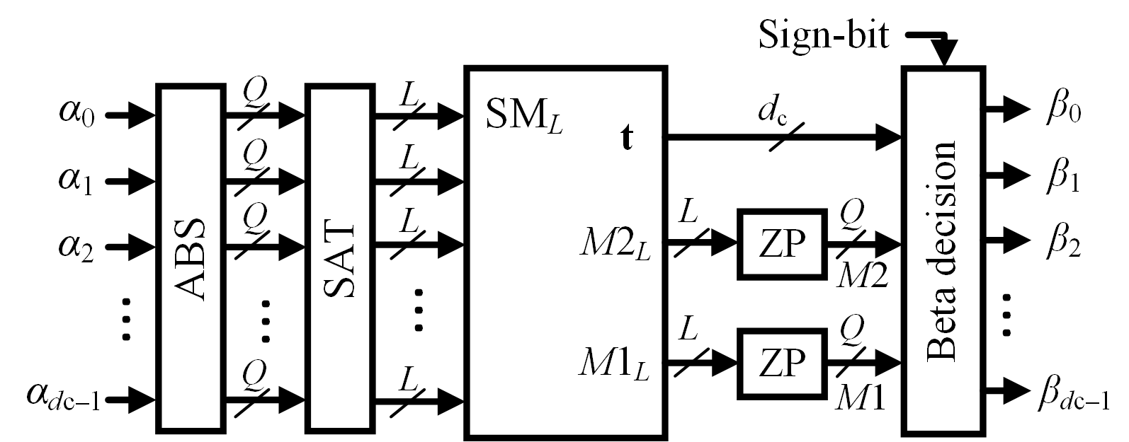
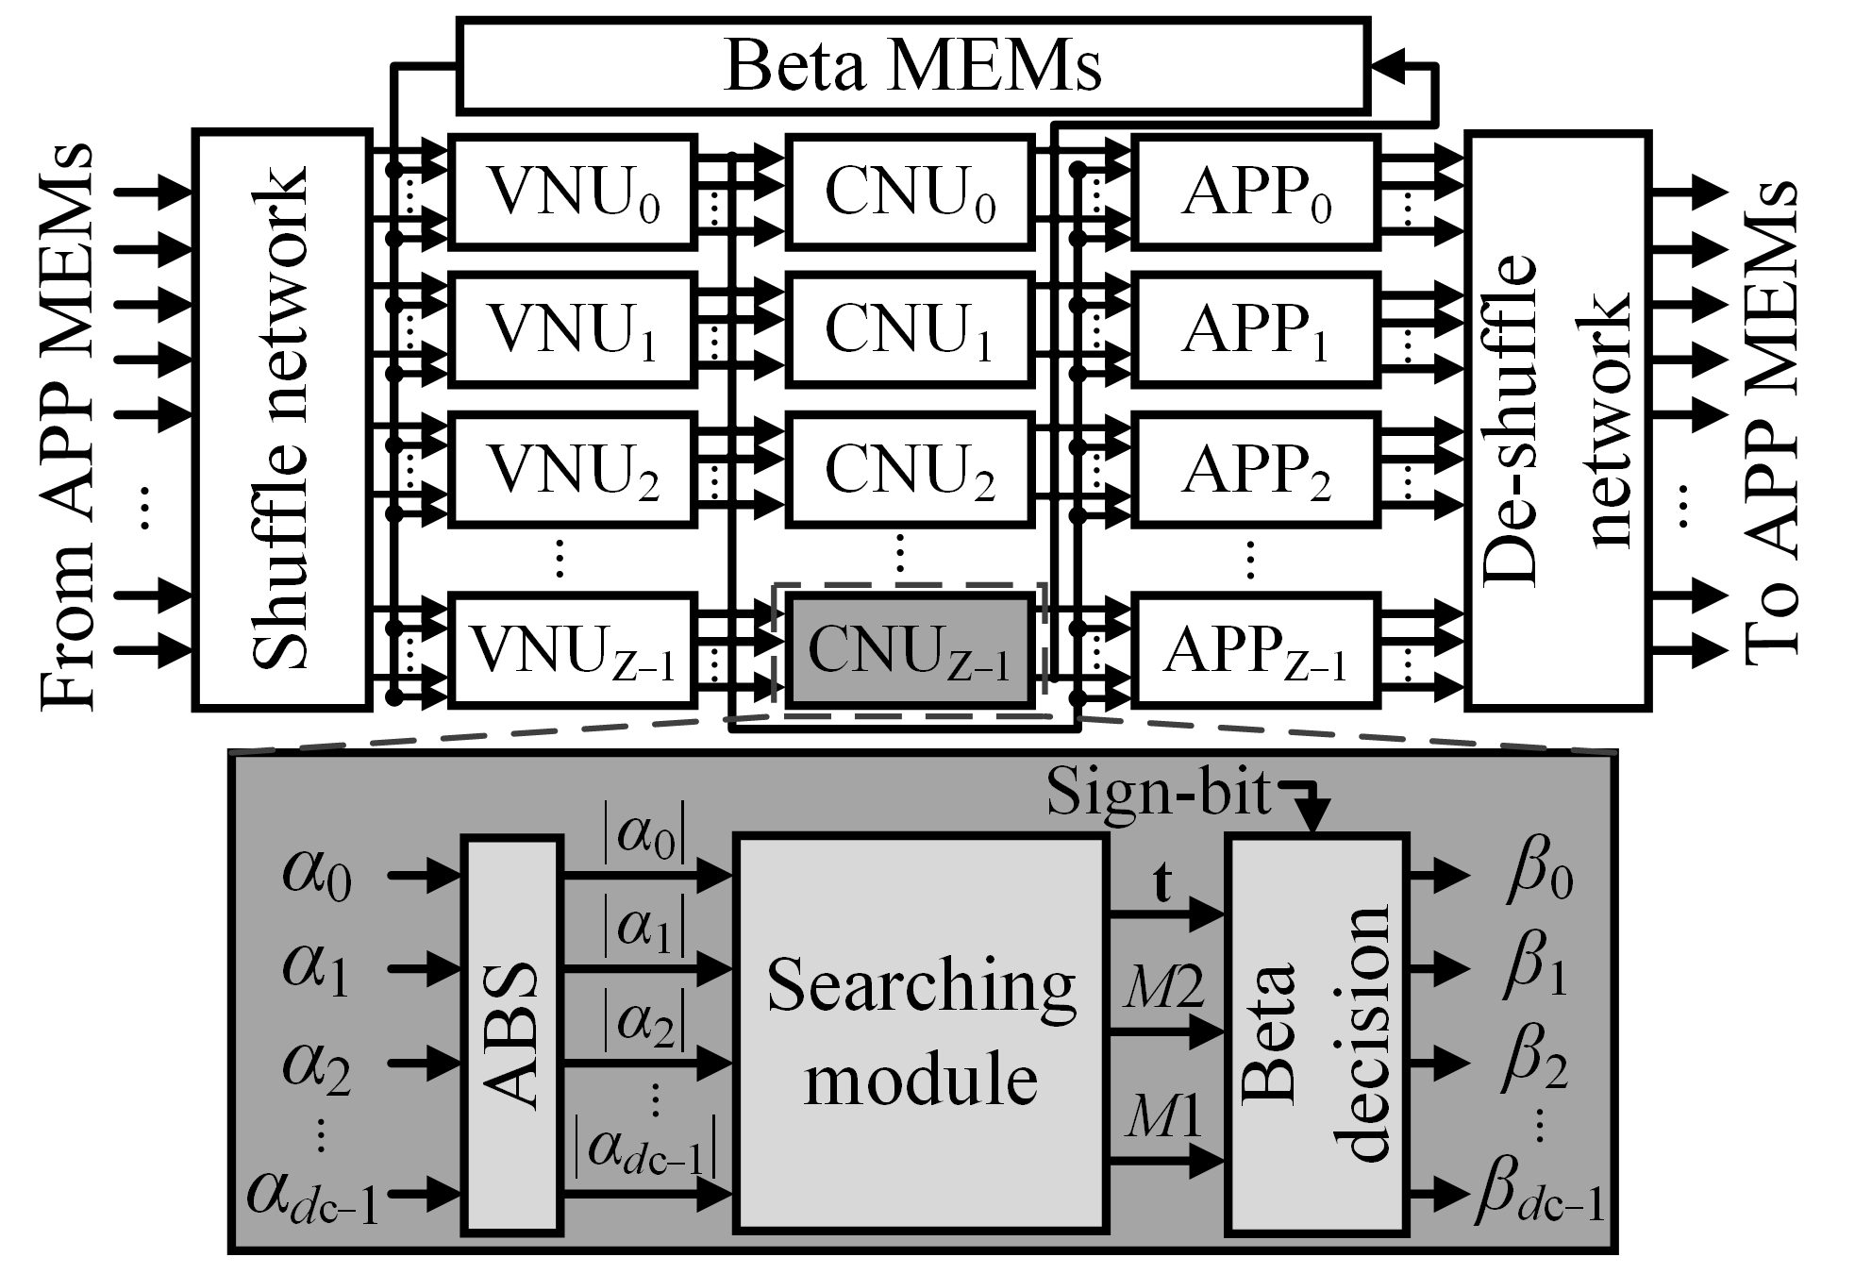
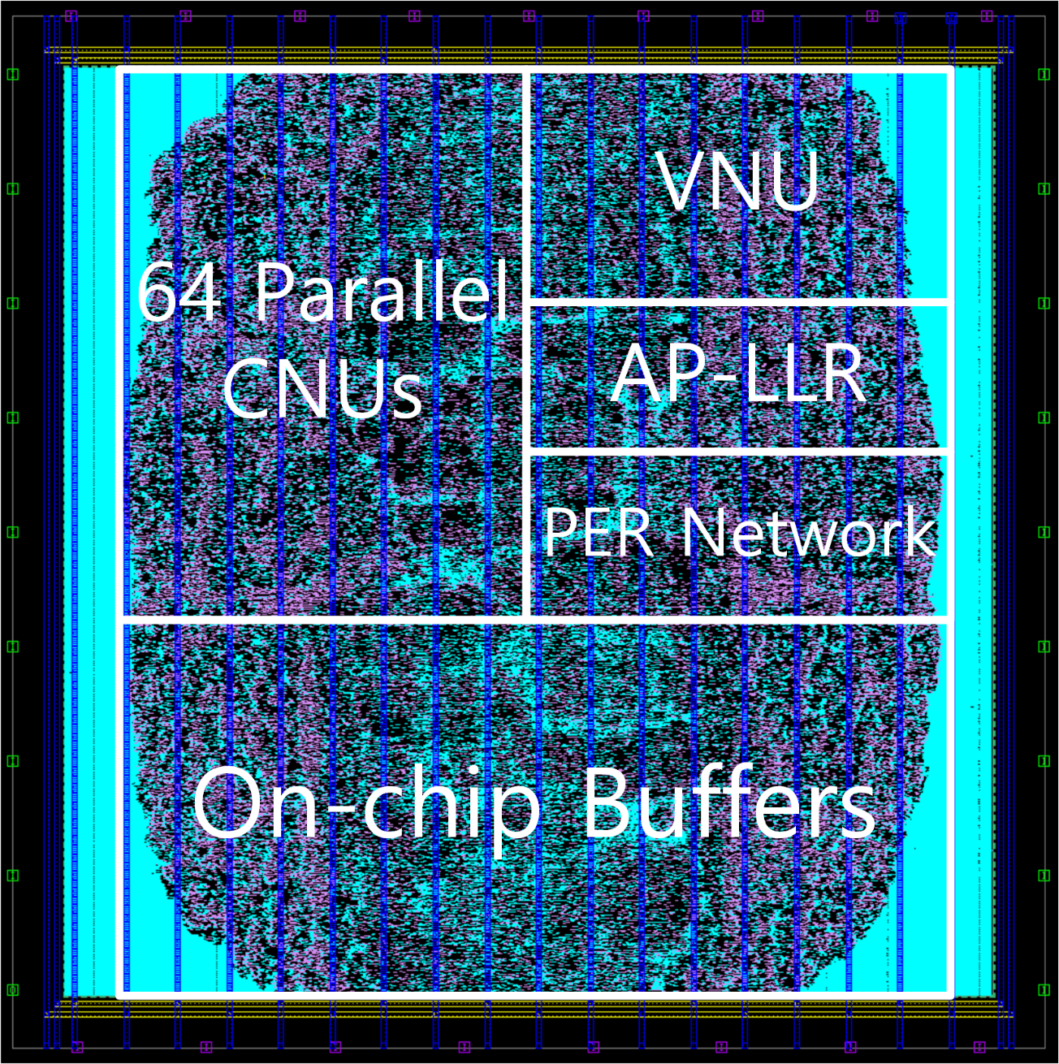
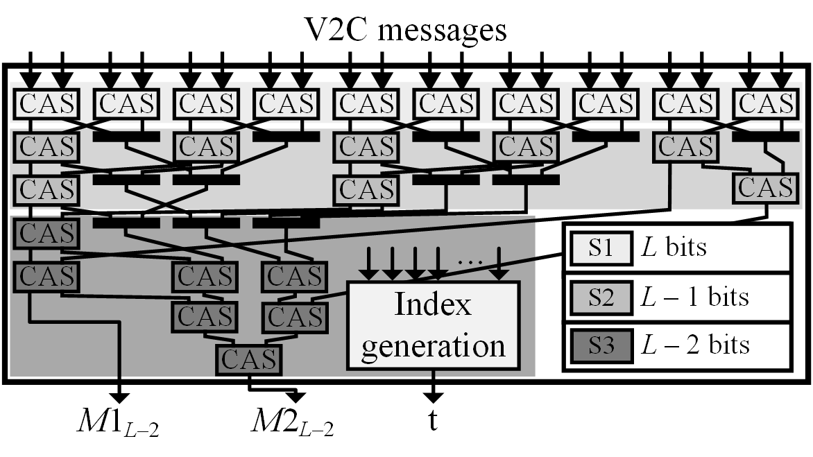
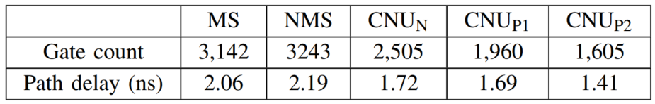
Area- and Energy-Efficient LDPC Decoder Using Mixed-Resolution Check-Node Processing
Sangbu Yun, Byeong Yong Kong and Youngjoo Lee
Department of Electrical Engineering, Pohang University of Science and Technology
Abstract
A practical min-sum algorithm is associated with tree-based comparison units for the check-node operation, being a major bottleneck in designing low-cost and energy-efficient low-density parity-check (LDPC) decoders. In this paper, we present a cost-effective LDPC decoder architecture by changing its internal computing resolution for the power-hungry check-node processing. The proposed mixed-resolution comparison offers significant advantages in terms of both area and energy, while achieving error-correcting performance within 0.3 dB of the previous normalized min-sum (NMS) algorithm for a (1644, 1408) quasi-cyclic LDPC code of the 5G New Radio specifications. Compared to the baseline NMS architecture, the proposed decoder in a 28nm CMOS technology reduces the hardware complexity and the power consumption by 34.0% and 36.2%, respectively, enhancing the area efficiency by more than 82.0%.
Proposed Design
BER Curves for 5G NR LDPC in AWGN channel
Naïve CNU architecture (CNU_{N})
Proposed CNU architecture #1 (CNU_{P1})
Proposed mixed-resolution architecture (CNU_{P2})
Comparison of Different CNU architectures
Error correcting performance for different CNUs
Implementation Results
Decoder layout
Comparison to other state-of-the-art decoders

